Slide 1
Maximizing the Efficiency of Forward Osmosis for Sustainable Water Filtration
Kaitlin Johnson
School for Engineering of Matter, Transport and Energy
Arizona State University
2012 NASA Space Grant Symposium
April 21, 2012

Slide 2
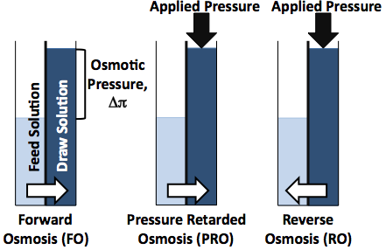
Osmosis: An Overview
Draw solutions for FO consist of concentrated solutions that can be more easily separated from the filtered water than previous contaminants.
Figure 1. Comparing Osmotic Processes
The differences between forward, pressure retarded, and reverse osmosis is illustrated in the differences between pressure application and the direction of water flux

Slide 3
Focusing on Forward Osmosis
A lack of efficient membranes prevents FO from being a viable option for large-scale water filtration.
Commercially available FO membranes are fabricated using cellulose triacetate.
Hydrolyzes and breaks down in solutions that have pH values around 8 and higher.
Limits options for draw solutions
Low water flux and salt rejection when compared to values achieved by commercial RO membranes in RO filtration.

Slide 4
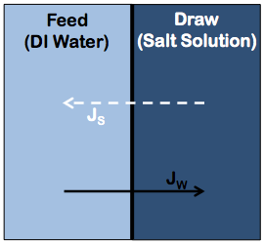
Reverse Draw Flux
Need for draw solutions that work well with currently available membranes.
Reverse draw flux describes the process of ion transfer to the feed solution while water is simultaneously flowing to the draw solution.
This phenomenon must be minimized to prevent waste of draw solutes.
Figure 2. Reverse Draw Flux
Illustration of flux that occurs across a membrane during forward osmosis
Notes:
Goal is to use a draw solution that can be easily separated from water in draw solution without further contaminating the feed solution

Slide 5
Forward Osmosis System Setup
Figure 3. Schematic of Forward Osmosis Testing Platform

Slide 6
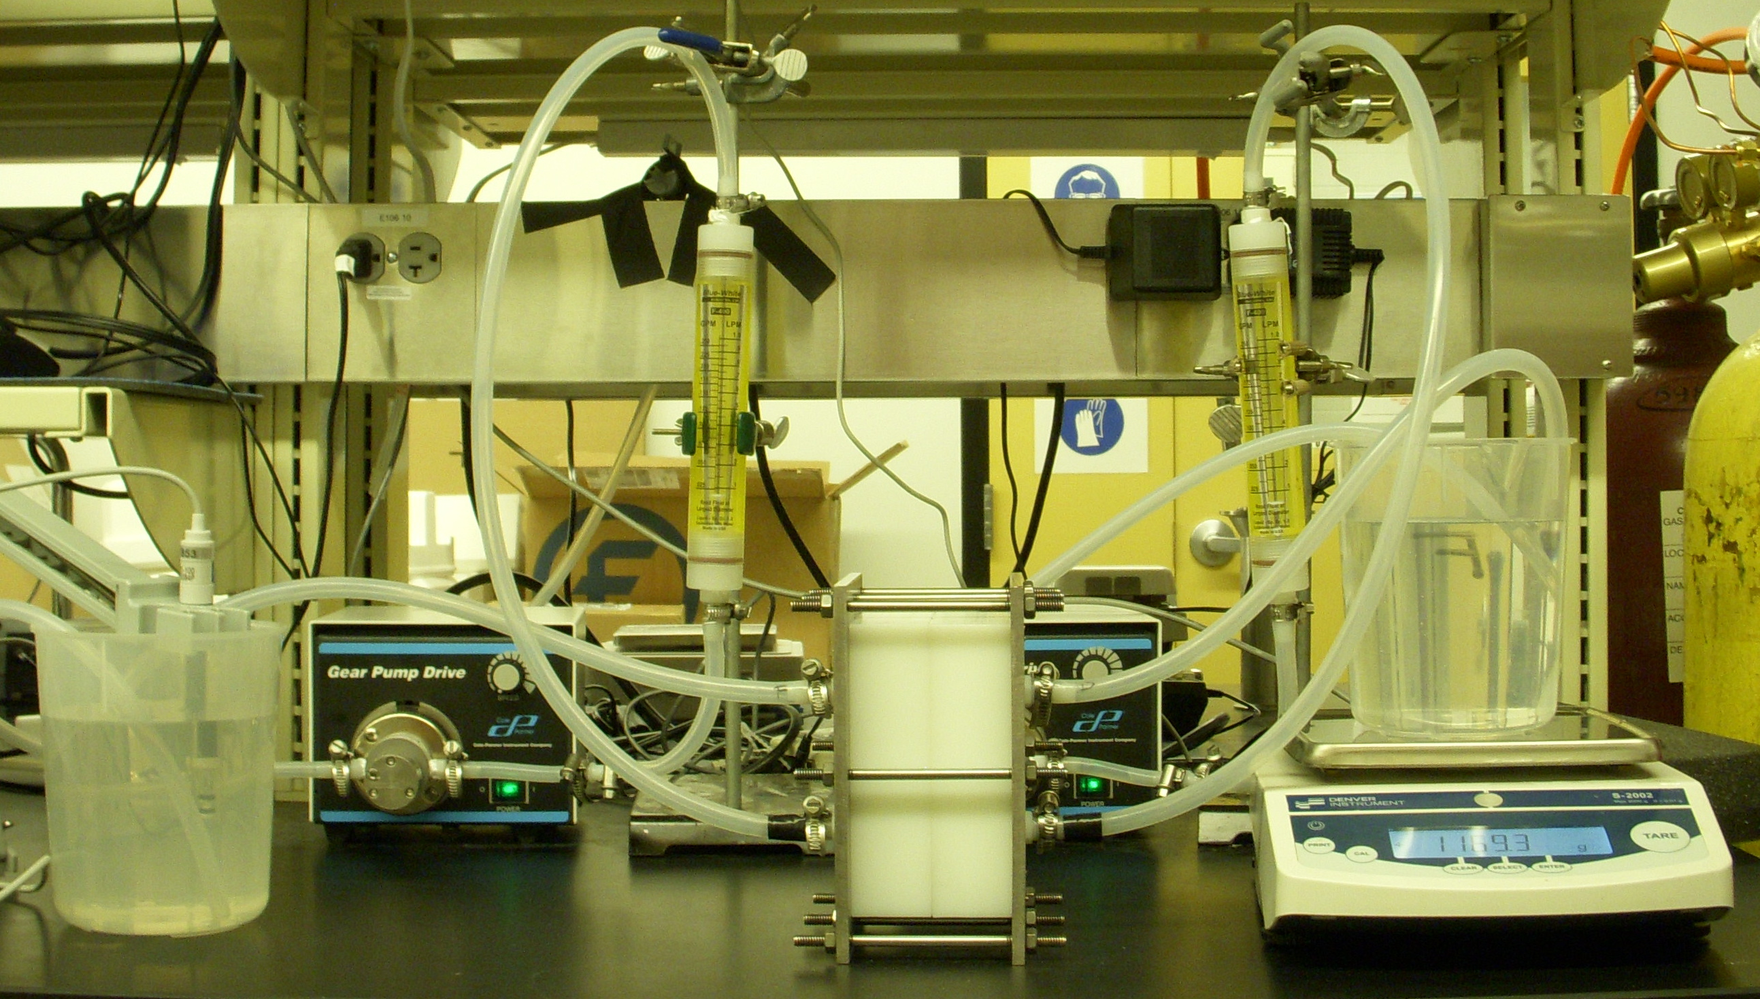

Slide 7
Membrane Characterization
Commercial Hydration Technology Innovations (HTI) cartridge FO membranes were used for testing.
Cellulose acetate cast on a polyester screen mesh
Membranes were tested in a HP4750 Sterlitech Stirred RO cell in order to determine parameters of membranes.
Four increments of 100 psi pressure were applied to a feed of deionized water.
Water flux was compared with pressure to determine the water permeability coefficient, A.
Procedure was also repeated with a feed of 50 mM sodium chloride to determine salt rejection in response to pressure.

Slide 8
Water Permeation
A=0.61Lm⁻²hr⁻¹bar⁻¹
Figure 4. Water Permeability Characterization Data

Slide 9
Salt Rejection
Figure 5. Salt Rejection Characterization Data

Slide 10
Draw Solute Comparative Study
Three salts were tested as potential draw solutes:
Magnesium chloride
Potassium chloride
Sodium chloride
Testing parameters:
Draw solution of 1.0 M concentration
Feed solution of deionized water
Flow rate of 1L/min
System run in a closed loop

Slide 11
Solute Data Comparison
Figure 6. Water Flux Results of Forward Osmosis Testing

Slide 12
Solute Data Comparison
Figure 7. Reverse Solute Flux Results of Forward Osmosis Testing

Slide 13
Current Conclusions
Of the three tested solutes, magnesium chloride currently presents the most promising results.
Highest water flux
Lowest reverse solute flux

Slide 14
Future Work
Further draw solute testing using solutions of:
Calcium chloride
Magnesium sulfate
Sodium sulfate
Potassium bromide
Sodium bromide
Testing of commercial seawater RO membranes with same solutions in FO testing module
Compilation of all data to be published in an academic journal

